Slide 1




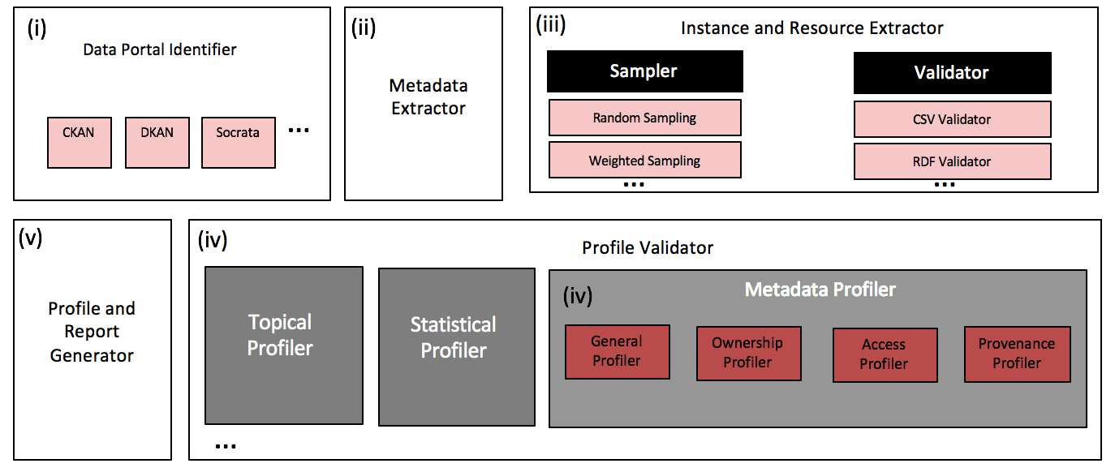
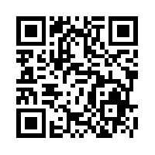
Roomba
Automatic Validation, Correction and Generation of Dataset Metadata - Enhancing Dataset Search and Spam Detection
Ahmad Assaf†, Raphaël Troncy† and Aline Senart‡
†EURECOM
Sophia Antipolis, France
firstname.lastname@eurecom.fr
‡ SAP Research, SAP Labs France SAS
Mougins, France
Aline.senart@sap.com
Data Portals
A curated collection of metadata about data sets providing discovery functionality to complement conventional browse-style catalogue interfaces
General information
General information about the dataset, e.g. title, description and ID. This general information is manually filled by the dataset owner. In addition to that, tags and group information are required for classification and enhancing dataset discoverability. This information can be entered manually or inferred using modules plugged into the topical profiler.
Access information
Information about accessing and using the dataset. This includes the dataset URL, license information (i.e. license title and URL) and information about the dataset's resources. Each resource has also a set of attached metadata, e.g. resource name, URL, format, size.
Ownership information
Information about the ownership of the dataset, e.g. organization details, maintainer details, author. The existence of this information is important to identify the authority on which the generated report and the newly corrected profile will be sent to.
Provenance information
Temporal and historical information on the dataset and its resources, e.g. creation and update dates, version information. Most of this information can be automatically filled up and tracked.
All results are reproducible from our code base at https://github.com/ahmadassaf/opendata-checker
This research has been partially funded by the European Union's 7th Framework Programme via the project Apps4EU (GA No. 325090)

